Slide 1
PROJECT TITLE : EFFICIENCY METER
PIP104 University Project-II
FINAL Review
Batch Number: 37
Roll Number | Student Name
20201CIT0081 | KARTHIK R
20201CIT0086 | RAJASHREE C
20201CIT0108 | ANKITH SHARMA M
Under the Supervision of,
Ms. STERLIN MINISH T N
Assistant Professor
School of Computer Science & Engineering
Presidency University

Slide 2
Introduction
In the rapidly evolving landscape of work, the Resource Time Tracker project responds to the need for a comprehensive tool in the face of technological advancements and remote work practices. The project addresses the challenge organizations face in monitoring and managing resource time, aiming to provide a systematic approach to capture, calculate, and analyze time spent on diverse professional activities. Its primary objectives include developing a user-friendly tool seamlessly integrated into professionals' workflows, implementing a centralized database for secure data storage, and introducing analytics functionalities for insightful reporting. The scope encompasses a thorough examination of time tracking for common professional activities, with a focus on a user-friendly interface and analytics generation. However, the project has limitations, such as no real-time tracking and no in-depth analysis of coding languages. The Resource Time Tracker adapts to the evolution of work practices, from the traditional office setting to the rise of remote work, providing insights into time allocation across different professional activities. Emphasizing the significance of time management, the project is rooted in the rationale of offering a holistic view of resource behavior and facilitating informed decision-making. Innovations include centralized data management and advanced analytics functionalities, distinguishing it from conventional time-tracking tools. Anticipated outcomes encompass improved resource allocation, identification of time-intensive processes, opportunities for optimization, and the cultivation of a culture of accountability. In conclusion, the Resource Time Tracker stands as an innovative solution poised to enhance organizational efficiency and resource productivity in the dynamic realm of modern work practices.

Slide 3
Literature Review
The literature survey encompasses various studies and articles, each contributing to distinct domains:
1. Enhancing Resource Time Management
Authors:Ariponnammal, S. and Natarajan, S. (2020)
Abstract: Explores time tracking and analytics solutions' role in improving organizational efficiency, critically assessing existing tools and proposing innovative approaches.
2. Time-Driven Productivity in Knowledge Work
Authors: Barnard, R.W. and Kellogg, C. (2021)
Abstract: Investigates the dynamics of time allocation in knowledge work, emphasizing time-driven productivity and strategies for optimizing productivity.
3. Innovations in Time Control
Authors:Shin, K.G. and Mckay, N.D. (2022)
Abstract:Explores open-loop minimum time control strategies in mechanical manipulations, offering insights applicable to resource time management.

Slide 4
4. Advanced Web Analytics for Mouse Tracking
Authors: Lukas Cegan and Petr Filip (November 2017)
Abstract: Introduces a real-time data processing solution for mouse tracking in web analytics, emphasizing significant data and resource savings.
5. ASTrack: Detection and Removal of Web Tracking Code
Authors: Ismael Castell-Uroz, Kensuke Fukuda, Pere Barlet-Ros (January 2023)
Abstract: Presents ASTrack, a solution for detecting and removing web tracking systems with minimal functionality loss, demonstrating high precision and reduced impact on website functionality.
6. Web-Based Item Tracking System Using RFID
Authors: Azinurrachman Maulana, Siti Aisyah, Prasaja Wikanta (September 2023)
Abstract: Describes a web-based RFID system for tracking laboratory items, enabling real-time inventory monitoring and history review.
7. Tracking Devices and Physical Performance Analysis in Team Sports
Authors:António FerrazP, Duarte-MendesJoão, Valente-Dos-Santos, Hugo Sarmento (November 2023)
Abstract:Reviews the extensive use of tracking devices in team sports, emphasizing the need for a cohesive framework for enhanced sports science research.

Slide 5
Research Gaps Identified
In the realm of resource time management, current methods exhibit notable gaps that impede a nuanced understanding of professional behavior. One significant shortfall lies in the granularity of time tracking. While existing tools allow for the logging of hours and broad categorization of activities, they often lack the capability to capture micro-level tasks and the variability in time allocation for similar activities. This deficiency hinders a comprehensive understanding of resource behavior, limiting the depth of insights derived from time-tracking data. A specific facet of this granularity gap is the absence of mechanisms for tracking and categorizing micro-tasks, which are often crucial but overlooked components of a professional's workload.
Another critical gap in existing methods is the inadequate integration of cognitive load considerations into the data capture process. Cognitive load, representing the mental effort required for tasks, significantly influences how professionals allocate their time. Current methods often neglect to incorporate cognitive load metrics, hindering the ability to comprehend the mental demands associated with different activities. Addressing this gap involves developing metrics that quantify mental effort and exploring the correlation between cognitive fatigue and productivity. The integration of cognitive load metrics allows for a more holistic interpretation of resource behavior, facilitating targeted interventions to manage workload effectively.

Slide 6
The justification for addressing these gaps is multifaceted. Enhancing decision-making precision is paramount, as fine-grained data enables organizations to make more informed decisions about resource allocation, project planning, and workflow optimization. Tailored resource allocation and dynamic project planning become possible with a deeper understanding of time allocation variability. Moreover, integrating cognitive load considerations fosters a cognitive-optimized work environment, supporting sustained focus, minimizing mental fatigue, and promoting overall well-being. Finally, addressing these gaps contributes to advancing organizational learning through a data-driven approach. The resulting rich dataset can be leveraged for the continuous improvement of operational processes, the identification of best practices, and the development of adaptive training programs tailored to individual cognitive capacities.

Slide 7
Proposed Methodology
The envisioned Resource Time Tracker is underpinned by a modular and scalable system architecture designed to cater to diverse time tracking and analytics needs. Comprising the Client-Side Application, Centralized Database, and Analytics Engine, this architecture ensures a user-centric experience, robust data storage, and insightful analytics. The Client-Side Application acts as the interface for resource interaction, offering accessibility across devices and simplifying time entry and task categorization. Meanwhile, the Centralized Database, employing a relational model, ensures data integrity, scalability, and efficient retrieval for analytics generation. The Analytics Engine, powered by advanced algorithms, processes raw time-tracking data into meaningful insights, supporting strategic decision-making within the organization.
The scalability and integration aspects of the proposed architecture are pivotal for organizational flexibility. The modular design allows easy integration with existing systems through API endpoints, ensuring interoperability. Moreover, the cloud-ready architecture, deployable on platforms like AWS or Azure, enhances scalability, security, and cost management through a pay-as-you-go model. The system is designed to scale horizontally, seamlessly accommodating a growing user base and expanding datasets.

Slide 8
The Data Capture Mechanism introduces precision and efficiency to time tracking. Real-time tracking and automated logging leverage machine learning for intelligent task categorization based on historical patterns. This not only minimizes manual effort but also ensures accurate and comprehensive data capture. In consideration of cognitive load, the system incorporates subjective and objective indicators. Users can subjectively report their perceived cognitive load, and the system objectively analyzes task complexity and concentration requirements, ensuring a holistic understanding of resource behavior.
The Centralized Database, designed with a normalized relational schema, optimizes data storage and retrieval efficiency. It includes tables for user profiles, time entries, project details, and task categories. Integrated with cloud-based storage, the database ensures data redundancy and scalability. Advanced features such as database replication and encrypted data storage address security concerns, enhancing fault tolerance and protecting sensitive information.
The Analytics Generation module employs advanced algorithms for transformative analytics. Time-series analysis identifies temporal patterns, while predictive modeling forecasts future trends. Customizable reporting and dashboards prioritize user accessibility, providing insights for individuals, project managers, and team leaders. Integration with business intelligence tools enhances the utility of analytics outputs, allowing organizations to correlate time-tracking data with broader metrics, fostering a deeper understanding of resource management's impact on organizational goals. The proposed methodology aims to revolutionize resource time management through a comprehensive, scalable, and user-friendly approach.

Slide 9
Objectives
The primary goal of this project is to establish the Resource Time Tracker, a comprehensive time tracking system designed to capture and categorize the time spent by resources on various activities. This involves implementing user-centric design principles, ensuring a seamless and intuitive interface for resource interaction. The system aims to achieve granularity in data capture, not only tracking macro-level tasks but also providing a detailed breakdown of micro-tasks, offering a nuanced perspective on resource behavior.
A crucial objective is the creation of a centralized database, serving as the backbone of the Resource Time Tracker. This database follows relational design principles and integrates cloud-based storage for data redundancy, disaster recovery, and scalability. The goal is to establish a robust data storage solution capable of efficiently handling the growing volume of time-related data generated by the system.

Slide 10
The project also focuses on implementing advanced analytics capabilities within the Resource Time Tracker. This involves employing machine learning, statistical analysis, and data visualization techniques to transform raw data into actionable insights. Time-series analysis is employed for pattern identification, while predictive modeling enables the forecasting of future resource trends. These analytics contribute to enhancing decision-making precision and agility within organizations.
Furthermore, the project emphasizes enhancing decision-making precision and agility by providing decision-makers with customizable reporting and dashboards. The system aims to offer tailored insights into resource management, project performance, and cognitive workload analysis. Customizable reporting allows organizations to filter insights based on specific criteria, supporting decision-making precision. Additionally, integration with business intelligence tools facilitates a deeper understanding of the impact of resource management on overall organizational goals, enhancing decision-making agility within the larger context of business operations.

Slide 11
System Design & Implementation
Interface Design:
The user-centric Interface Design for the Resource Time Tracker focuses on creating an intuitive and engaging experience. Following minimalist principles, the design emphasizes clarity and simplicity in visual elements. Intuitive navigation ensures users can seamlessly move through the application, enhancing overall satisfaction. The responsive design caters to diverse devices, adapting dynamically for optimal viewing and interaction. The core functionality revolves around real-time entry and activity logging, featuring user-friendly forms and prompts. Task categorization mechanisms support granularity in time tracking, allowing users to categorize activities into macro and micro-tasks. The dashboard, a central component, provides insights into productivity trends and cognitive load indicators, enhancing the user's understanding of their work habits.
Database Implementation:
The Database Implementation adheres to a normalized relational schema, optimizing data storage and retrieval efficiency. The User Profiles Table captures essential user information, serving as the foundation for authentication and personalization. The Time Entries Table stores detailed records, including timestamps, task

Slide 12
descriptions, and cognitive load indicators, providing granular data for analytics. Cloud-based storage integration ensures data accessibility, scalability, and fault tolerance. Database replication mechanisms maintain synchronized copies, enhancing system reliability. Encrypted data storage in the cloud addresses security concerns, aligning with industry best practices for data protection.
Analytics Module:
The Analytics Module employs advanced algorithms to transform raw time-tracking data into actionable insights. Time-series analysis identifies temporal patterns, contributing to dynamic resource management. Predictive modeling techniques forecast future trends based on historical data, empowering organizations with proactive decision-making capabilities. Customizable reporting and dashboards prioritize user accessibility, providing tailored insights. User-level dashboards empower individual resources to reflect on their work patterns. Project and team analytics support performance evaluations and workflow optimizations. Integration with business intelligence tools enhances the utility of analytics outputs, allowing organizations to merge time-tracking data with broader metrics for a holistic view of resource management.
In summary, the Resource Time Tracker's implementation details showcase a user-centric interface, a robust database, and an analytics module that collectively aim to provide a comprehensive and efficient time-tracking solution for organizations. The integration of advanced features ensures adaptability, precision, and agility in resource management and decision-making processes.

Slide 13
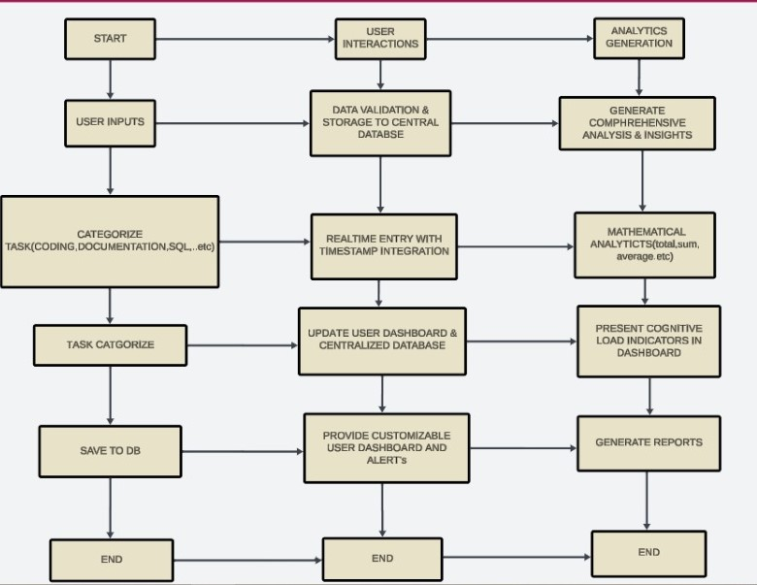
FLOWCHART

Slide 14
Timeline of Project
Gantt Chart Overview:
The execution timeline for the Resource Time Tracker project is meticulously presented through a Gantt Chart. This project management tool offers a visual representation of tasks, dependencies, and progress over time. Tasks are systematically identified, sequenced, and categorized into phases like Planning, Development, Testing, Deployment, and Maintenance. The Gantt Chart ensures a comprehensive view of the project's trajectory, aiding in effective planning and execution.
Gantt Chart Components:
Components of the Gantt Chart include task names and descriptions, start and end dates, and task assignees. Each task is clearly defined, providing a brief description of its objectives and deliverables. Start and end dates offer a timeline for task initiation and completion, aiding in tracking progress. Task assignees are identified to establish accountability and ensure a clear understanding of responsibilities.

Slide 15
Milestones and Achievements:
Milestones within the project serve as significant points of achievement and progress. Notable milestones include Project Initiation, marking the commencement of the project, and System Design Completion, signifying the detailed design specifications for the interface, database, and analytics modules. Each milestone is associated with specific deliverables, a review and approval process, and celebration events to acknowledge team efforts.
Celebrating Achievements:
Acknowledging achievements and celebrating milestones are crucial for team morale and motivation. Milestone celebrations include team recognition events where efforts, dedication, and collaboration are acknowledged. Stakeholder involvement in these events fosters a sense of shared achievement, reinforcing the project's significance within the organizational context.
Timeline Monitoring and Adjustments
Regular progress reviews are scheduled to assess task completion, identify challenges, and make necessary adjustments. Progress metrics, such as task completion percentages, inform decision-making on resource allocation and task prioritization. Contingency planning is implemented to address unforeseen challenges or delays, involving a proactive risk assessment process and mitigation strategies to ensure project resilience.
In conclusion, the Gantt Chart provides a dynamic and visual representation of the Resource Time Tracker project's execution plan. Milestones and celebrations contribute to team motivation, and regular monitoring ensures adaptability to changes, fostering successful project completion.

Slide 16
Outcomes / Results Obtained
The anticipated outcomes for a Time Tracking Web Tool encompass a comprehensive set of improvements designed to enhance organizational efficiency, productivity, and project management. Firstly, users can expect a substantial boost in productivity facilitated by improved time management capabilities. The Time Tracking Web Tool offers clearer visibility into tasks and facilitates streamlined workflows, empowering individuals and teams to make the most effective use of their time.
Accurate project tracking stands as another significant outcome, providing a reliable means to monitor project timelines, milestones, and resource allocation. This precision contributes to more accurate project planning and execution, ultimately ensuring that projects are delivered on time and within scope. Moreover, organizations can achieve effective resource management by gaining detailed insights into how time is allocated across various tasks and projects. This understanding enables optimized resource allocation, directing teams towards high-priority tasks and enhancing overall project efficiency.
Real-time monitoring is a key feature of the Time Tracking Web Tool, allowing stakeholders to track tasks and projects as they unfold. This capability enables prompt identification of potential delays and facilitates timely decision-making. The tool's data-driven approach is another significant outcome, generating comprehensive reports and analytics. Decision-makers can leverage these insights to make informed and strategic decisions, aligning project efforts with organizational goals. Overall, these anticipated outcomes collectively contribute to a more streamlined, collaborative, and effective approach to project management within the organization.

Slide 17
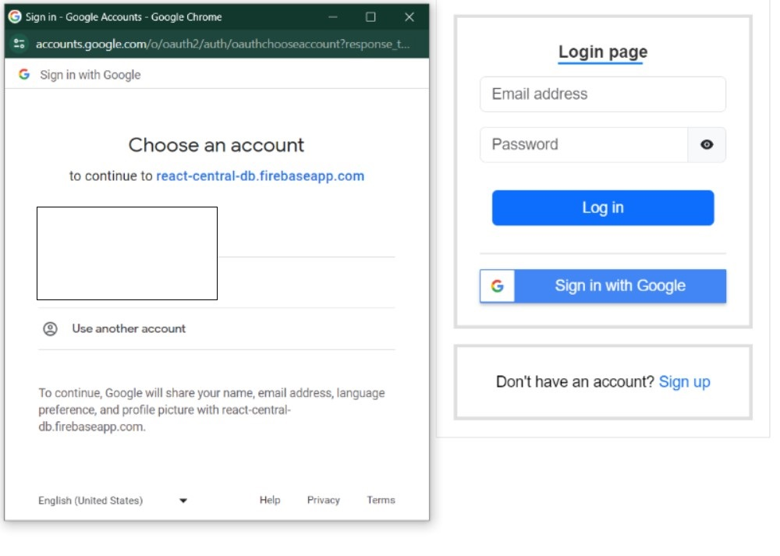
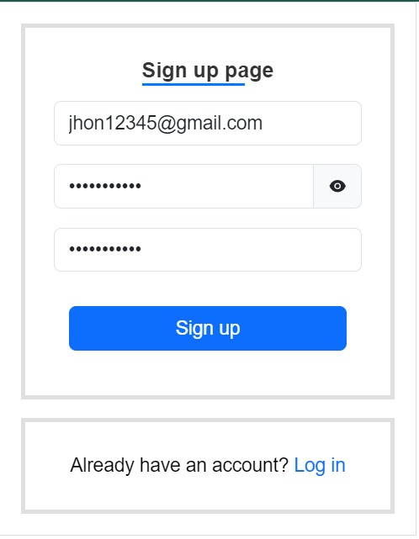
Login Page
Signup Page

Slide 18
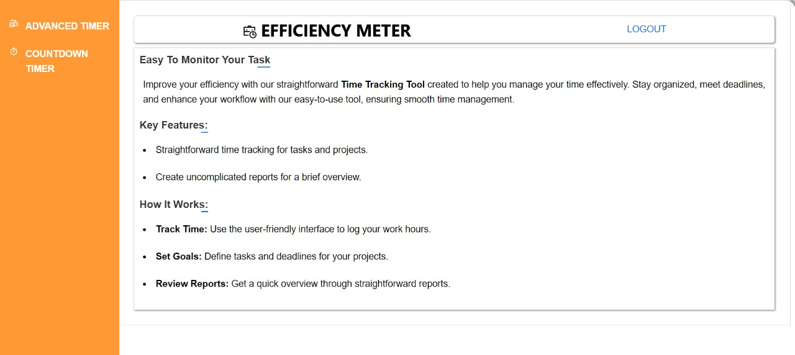
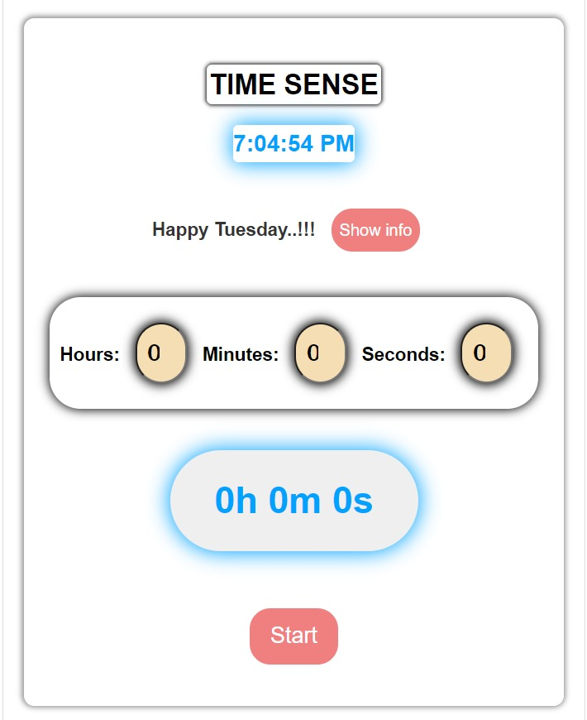
Home Page
Manual Timer

Slide 19
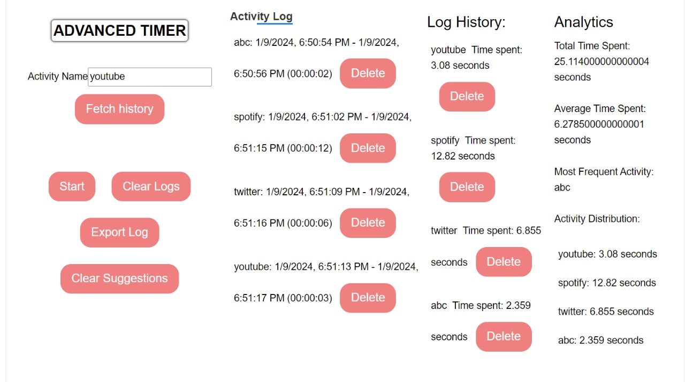
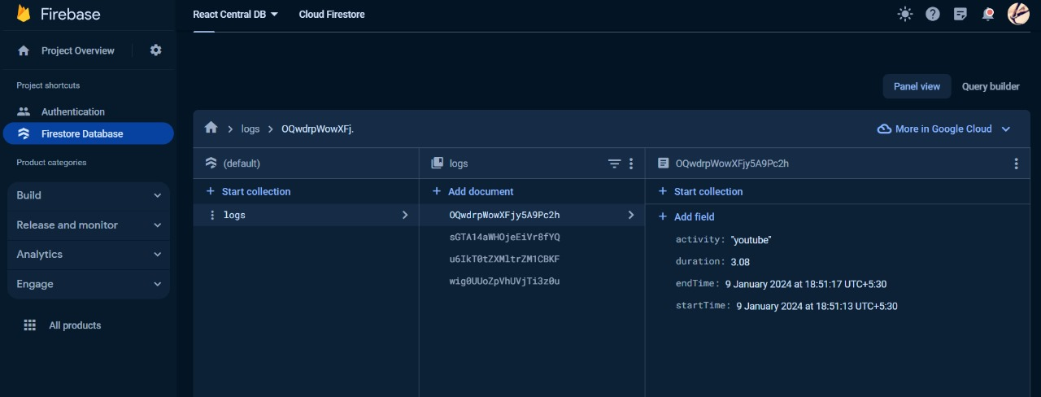
Analysis
Firebase Database

Slide 20
Conclusion
In conclusion, the implementation of the React.js-powered Resource Time Tracker has provided valuable insights into resource time management within the organization. The findings encompass a detailed understanding of time allocation patterns, identification of most time-consuming activities, and a nuanced analysis of project-based efficiency. Leveraging React.js components, the system has demonstrated its effectiveness, with positive indicators of user satisfaction, accurate data capture, and enhanced decision-making precision.
Moving forward, the organizational implications are significant, offering opportunities to refine resource allocation strategies and optimize project workflows. The iterative development of the system should prioritize continuous user feedback incorporation, ensuring ongoing user training and support, and refining algorithms based on evolving needs. The future development roadmap suggests considerations for integrating emerging technologies, expanding analytical capabilities, and addressing ethical considerations related to data privacy. Collaboration with stakeholders remains a key focus, emphasizing the importance of ongoing communication to align the React.js-powered Resource Time Tracker with organizational goals.

Slide 21
References
[1] Ariponnammal, S. and Natarajan, S. (2020) 'Enhancing Resource Time Management.
[2] Barnard, R.W. and Kellogg, C. (2021) 'Time-Driven Productivity.
[3] Shin, K.G. and Mckay, N.D. (2022) 'Innovations in Time Control.
[4] Advanced web analytics tool for mouse tracking and real-time data processing, published on November 2017.By: Lukas Cegan and Petr Filip.
[5] ASTrack: Automatic Detection and Removal of Web Tracking Code with Minimal Functionality Loss, published on January 2023
Authors: Ismael Castell-Uroz, Kensuke Fukuda, Pere Barlet-Ros.
[6] Web-Based Item Tracking System Using RFID, published on September 2023
By: Azinurrachman Maulana, Binus University, Siti Aisyah and Prasaja Wikanta,

Slide 22
[7] Tracking devices and physical performance analysis in team sports: a comprehensive framework for research—trends and future directions, published on November 2023.
By: António FerrazP, Duarte-MendesJoão, Valente-Dos-Santos and Hugo Sarmento.
[8] Personal Knowledge Graphs (PKGs) Methodology, tools and applications, published on November 2022.
By: Fernando Ortiz-Rodríguez, Sanju Mishra Tiwari, François Scharffe and Manas Gaur.
[9] The Development of a Web Application for Tracking Medical Cannabis Products, June 2023.
By: Nuttapol Saenkham, Zagon Bussabong and Thippawan Saenkham.
[10] Citation tracking for systematic literature searching: a scoping review (CINAHL), January 2023.
By: Julian Hirt, Hannah Ewald, Thomas Nordhausen and Christian Appenzeller-Herzog.

Slide 23
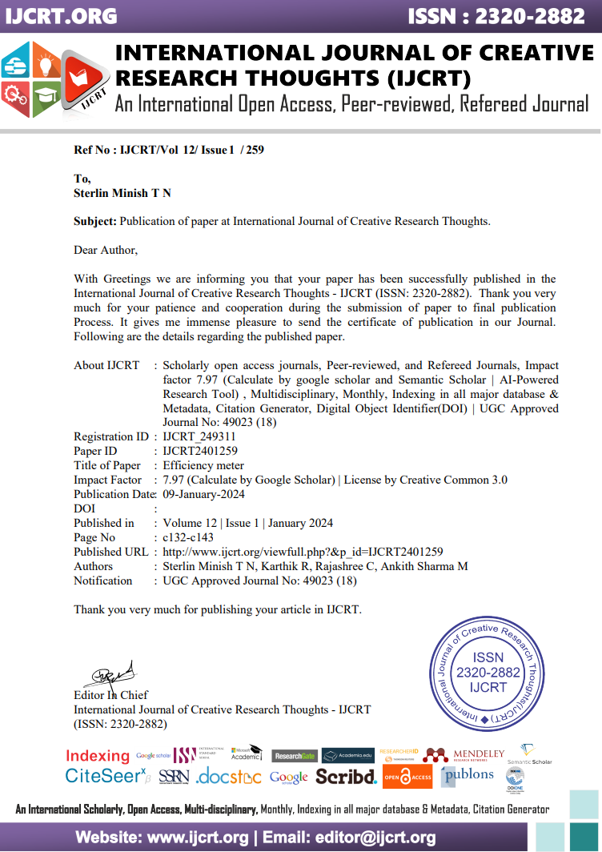
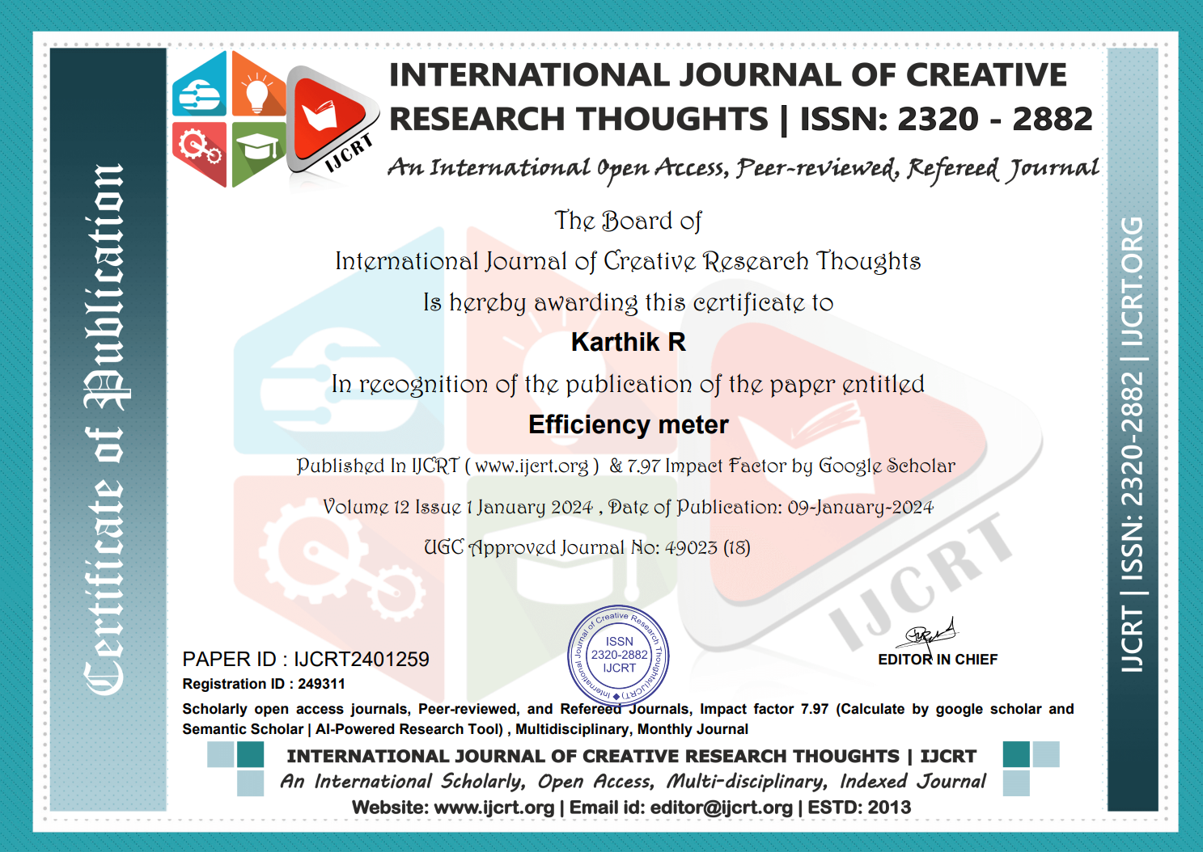
Publication Details

Slide 24
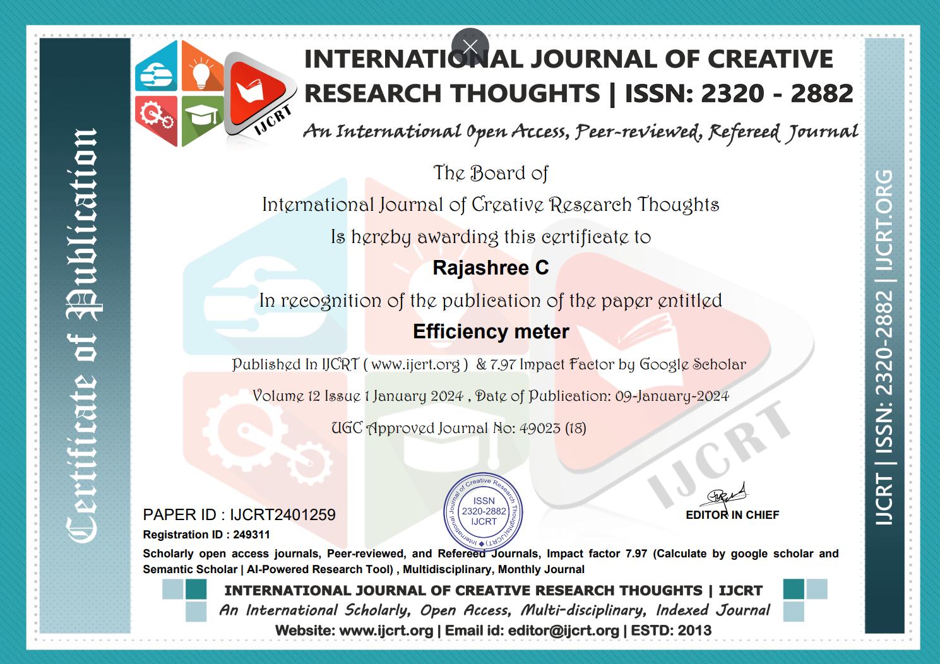
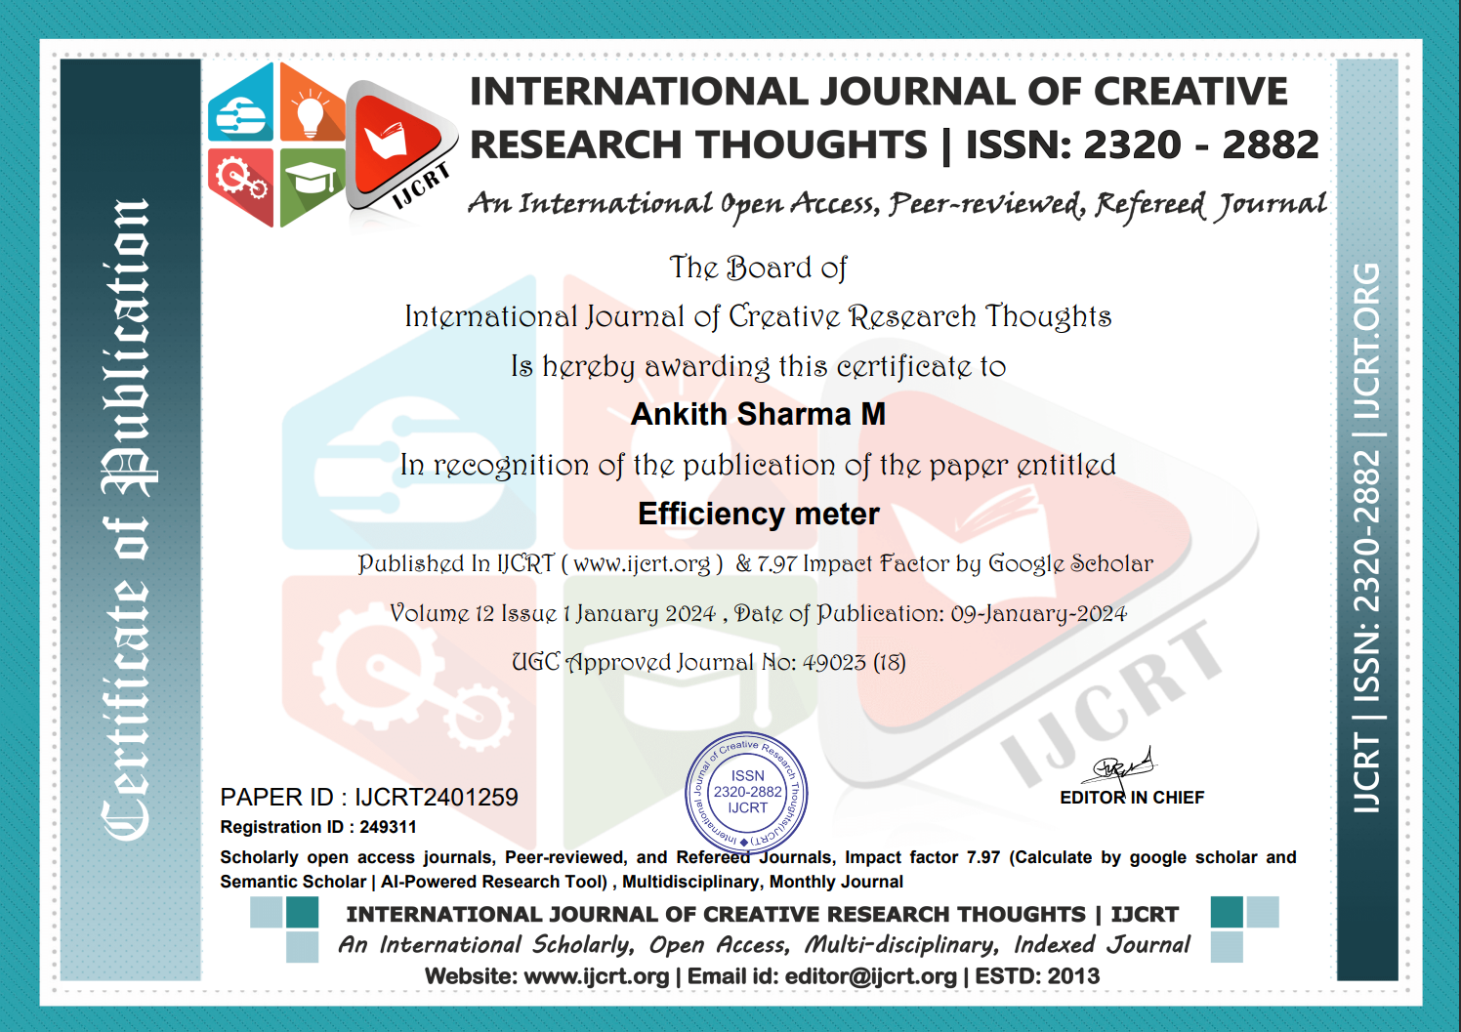

Slide 25

Thank You

